Slide 1
Latent Variable Models (LVMs)
CS771: Introduction to Machine Learning
Piyush Rai

Slide 2

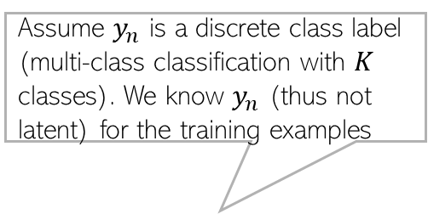
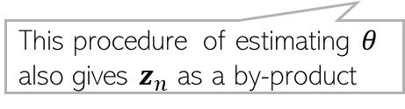


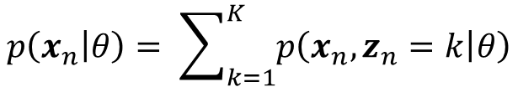

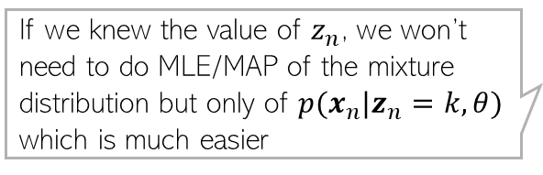



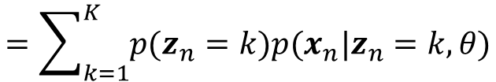



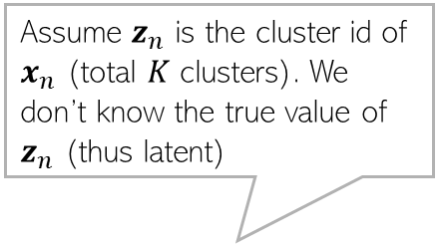
Example: Generative Models with Latent Variables
Two generative models of inputs $x_{n}$ without (left) and with (right) latent variables
Suppose we wish to estimate (e.g., using MLE/MAP) params $θ$ of distribution of $x_{n}$
For case 1, the distribution is $p(x_{n}|y_{n},θ)$ and MLE/MAP of $θ$easy since $y_{n}$ is known
For case 2, distribution is more complex because true $z_{n}$ is not known
If we knew the value of $z_{n}$, we won’t need to do MLE/MAP of the mixture distribution but only of $p(x_{n}|z_{n}=k,θ)$ which is much easier
Assume $z_{n}$ is the cluster id of $x_{n}$ (total $K$ clusters). We don’t know the true value of $z_{n}$ (thus latent)
Assume $y_{n}$ is a discrete class label (multi-class classification with $K$ classes). We know $y_{n}$ (thus not latent) for the training examples
$$θ$$
$$θ$$
When $z_{n}$ is not known, we can estimate $θ$ using an alternating estimating procedure: Estimate $z_{n}$ given $θ$ and estimate $θ$ given $z_{n}$
$$y_{n}$$
$$x_{n}$$
$$z_{n}$$
$$x_{n}$$
$$N$$
This procedure of estimating $θ$ also gives $z_{n}$ as a by-product
$$N$$
Reason: The functional form of mixture can be messy
$$p\left(x_{n} | θ\right)= \sum_{k=1}^{K}{p\left(x_{n},z_{n}=k | θ\right)}$$
$$=\sum_{k=1}^{K}{p(z_{n}=k)p(x_{n}|z_{n}=k,θ)}$$
MLE/MAP a bit difficult for this more complex “mixture” of distributions

Slide 3

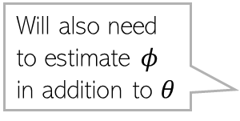






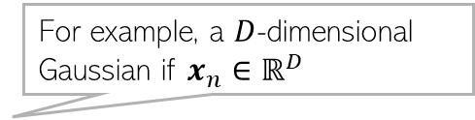
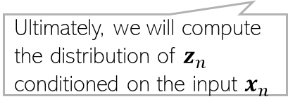

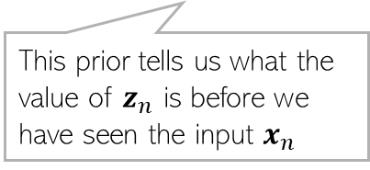
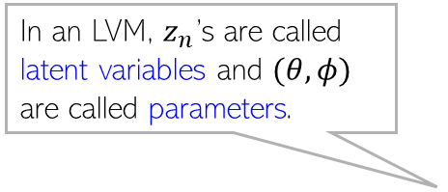
Components of an LVM
3
Recall that the goal is to estimate $θ$ (and $z_{n}$ is also unknown)
In LVM, we treat $z_{n}$ as a random variable and assume a prior distribution $p(z_{n}|φ)$
We will also assume a suitable conditional distribution $p(x_{n}|z_{n},θ)$for $x_{n}$
The form of $p(z_{n}|φ)$ will depend on the nature of $z_{n}$, e.g.,
If $z_{n}$ is discrete with $K$ possible values, $p\left(z_{n} | φ\right)=multinoulli(z_{n}|π)$
If $z_{n}∈ℝ^{K}$, $p\left(z_{n} | φ\right)=𝒩(z_{n}|μ, Σ)$, a $K$-dim Gaussian
In an LVM, $z_{n}$’s are called latent variables and $(θ,φ)$ are called parameters.
$$θ$$
This prior tells us what the value of $z_{n}$ is before we have seen the input $x_{n}$
Will also need to estimate $φ$ in addition to $θ$
$$p(z_{n}|φ)$$
$$p(x_{n}|z_{n},θ)$$
Ultimately, we will compute the distribution of $z_{n}$ conditioned on the input $x_{n}$
$$φ$$
$$z_{n}$$
$$x_{n}$$
$$N$$
For example, a $D$-dimensional Gaussian if $x_{n}∈ℝ^{D}$

Slide 4


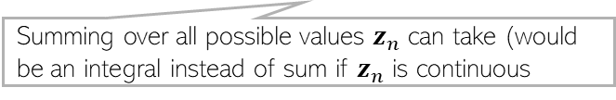
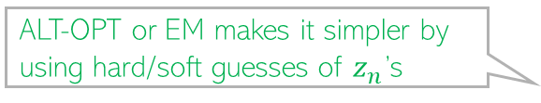
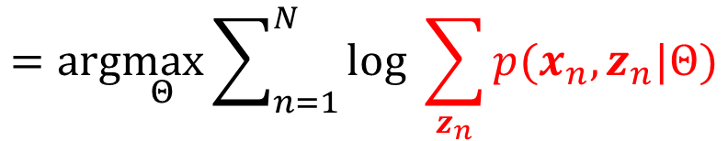
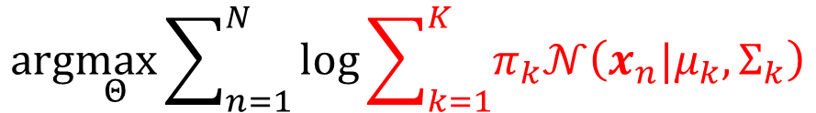
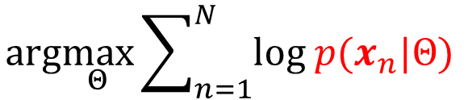
Why Direct MLE/MAP is Hard for LVMs?
4
Direct MLE/MAP of parameters $\left(θ,φ\right)=Θ$ without estimating $z_{n}$ is hard
Reason: Given $N$ observations $x_{n},n=1,2,…, N$, the MLE problem for $Θ$ will be
For a mixture of $K$ Gaussians, $p(x_{n}|Θ)$ will be
The MLE problem for GMM would be
Also note that $p\left(x_{n},z_{n} | Θ\right)=p\left(z_{n} | φ\right)p(x_{n}|z_{n},θ)$
$$arg\max_{Θ}\sum_{n=1}^{N}{log p(x_{n}|Θ) }$$
$$=arg\max_{Θ}\sum_{n=1}^{N}{log \sum_{z_{n}}{p(x_{n},z_{n}|Θ)}}$$
Summing over all possible values $z_{n}$ can take (would be an integral instead of sum if $z_{n}$ is continuous
Gaussian Mixture Model (GMM).
$$p\left(x_{n} | Θ\right)= \sum_{k=1}^{K}{p\left(x_{n},z_{n}=k | Θ\right)}=\sum_{k=1}^{K}{p\left(z_{n}=k | φ\right)p(x_{n}|z_{n}=k,θ)}=\sum_{k=1}^{K}{π_{k}𝒩\left({x_{n}|μ}_{k},Σ_{k}\right)}$$
ALT-OPT or EM makes it simpler by using hard/soft guesses of $z_{n}$’s
The log of sum doesn’t give us a simple expression; MLE can still be done using gradient based methods but updates will be complicated.
$$arg\max_{Θ}\sum_{n=1}^{N}{log\sum_{k=1}^{K}{π_{k}𝒩\left({x_{n}|μ}_{k},Σ_{k}\right)}}$$

Slide 5
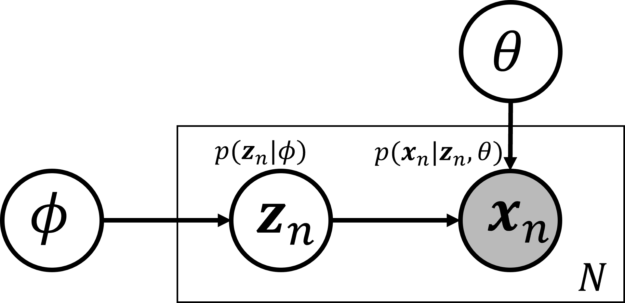
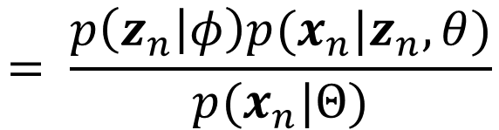
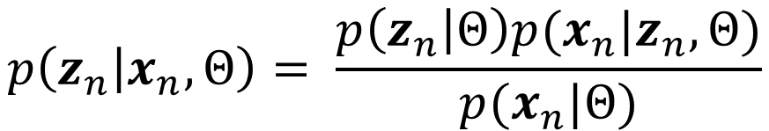

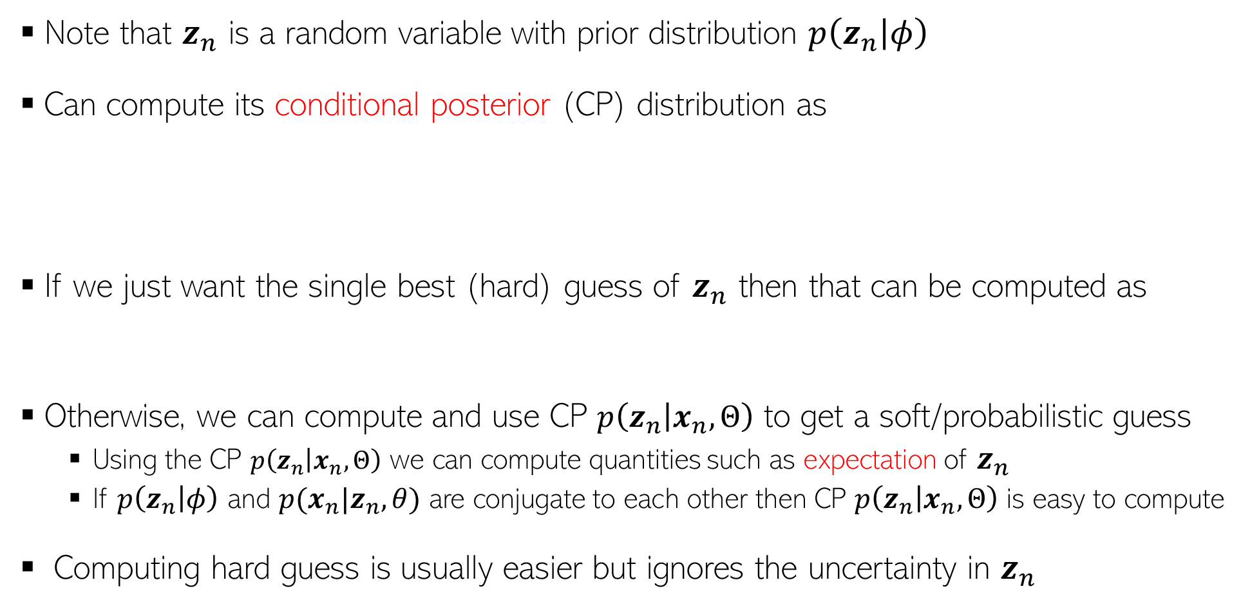

How to Guess $z_{n}$ in an LVM?
Note that $z_{n}$ is a random variable with prior distribution $p\left(z_{n} | φ\right)$
Can compute its conditional posterior (CP) distribution as
If we just want the single best (hard) guess of $z_{n}$ then that can be computed as
Otherwise, we can compute and use CP $p\left(z_{n} | x_{n},Θ\right)$ to get a soft/probabilistic guess
Using the CP $p\left(z_{n} | x_{n},Θ\right)$ we can compute quantities such as expectation of $z_{n}$
If $p\left(z_{n} | φ\right)$ and $p(x_{n}|z_{n}, θ)$ are conjugate to each other then CP $p\left(z_{n} | x_{n},Θ\right)$ is easy to compute
Computing hard guess is usually easier but ignores the uncertainty in $z_{n}$
Called conditional posterior because it is conditioned on data as well as $Θ$(assuming we have already estimated $Θ)$
$$\left(θ,φ\right)=Θ$$
$$p\left(z_{n} | x_{n},Θ\right)= \frac{p\left(z_{n} | Θ\right)p(x_{n}|z_{n}, Θ)}{p(x_{n}|Θ)}$$
$$= \frac{p\left(z_{n} | φ\right)p(x_{n}|z_{n}, θ)}{p(x_{n}|Θ)}$$
Used in ALT-OPT for LVMs
$${\hat{z}}_{n}= {argmax}_{z_{n}} p\left(z_{n} | x_{n},Θ\right)= {argmax}_{z_{n}} p\left(z_{n} | φ\right)p(x_{n}|z_{n}, θ)$$
Used in Expectation-Maximization (EM) algo for LVMs

Slide 6

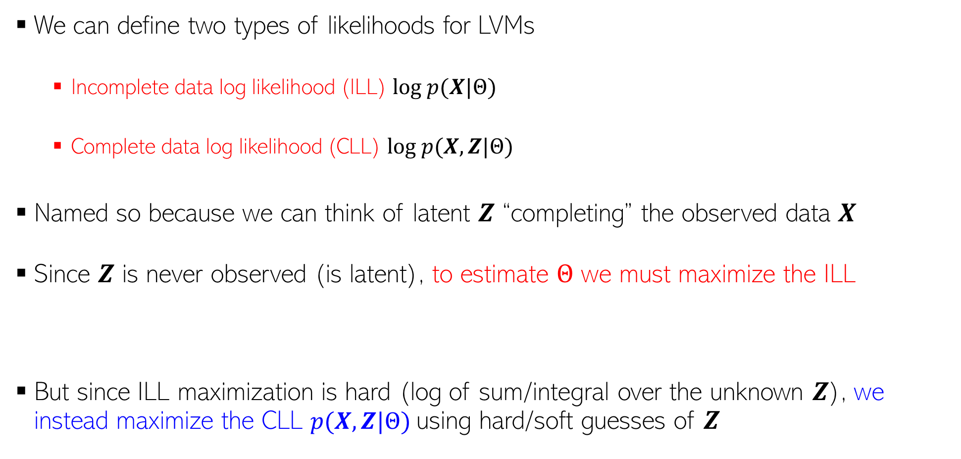




LVMs: Incomplete vs Complete Data Log Likelihood
$$θ$$
We can define two types of likelihoods for LVMs
Incomplete data log likelihood (ILL) $log p(X|Θ)$
Complete data log likelihood (CLL) $log p(X,Z|Θ)$
Named so because we can think of latent $Z$ “completing” the observed data $X$
Since $Z$ is never observed (is latent), to estimate $Θ$ we must maximize the ILL
But since ILL maximization is hard (log of sum/integral over the unknown $Z$), we instead maximize the CLL $p(X,Z|Θ)$using hard/soft guesses of $Z$
$$φ$$
$$z_{n}$$
$$x_{n}$$
$$N$$
$arg\max_{Θ}$ $log p\left(X | Θ\right)=arg\max_{Θ} log \sum_{Z}{p(X,Z|Θ)}$

Slide 7

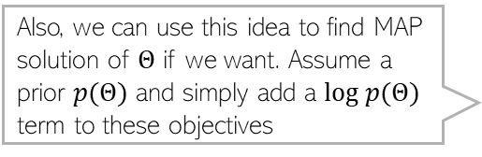

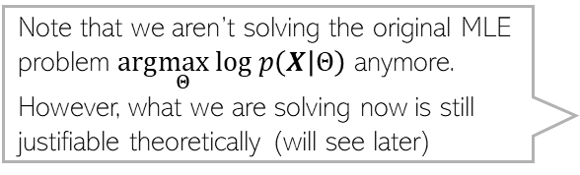
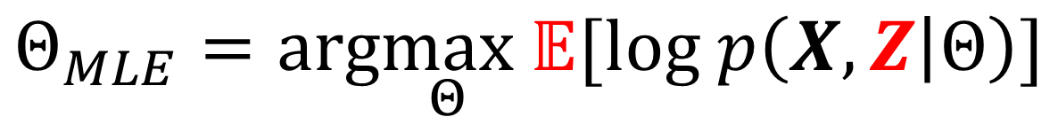
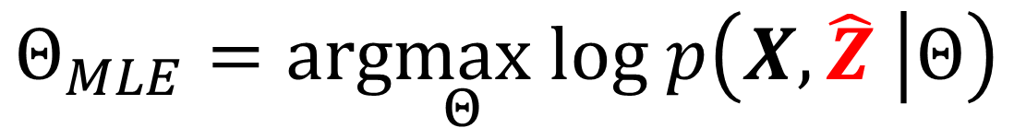
MLE for LVM
Also, we can use this idea to find MAP solution of $Θ$ if we want. Assume a prior $p(Θ)$ and simply add a $log p(Θ)$ term to these objectives
Note that we aren’t solving the original MLE problem $arg\max_{Θ}$ $log p\left(X | Θ\right)$ anymore. However, what we are solving now is still justifiable theoretically (will see later)
If using a hard guess
If using a soft (probabilistic) guess
In LVMs, hard and soft guesses of $Z$ would depend on $Θ$ (since $Z$ and $Θ$ are coupled)
Thus we need a procedure which alternates between estimating $Z$ and estimating $Θ$
$$Θ_{MLE}=arg\max_{Θ} log p\left(X,\hat{Z} | Θ\right)$$
$$Θ_{MLE}=arg\max_{Θ} 𝔼[log p\left(X,Z | Θ\right)]$$

Slide 8
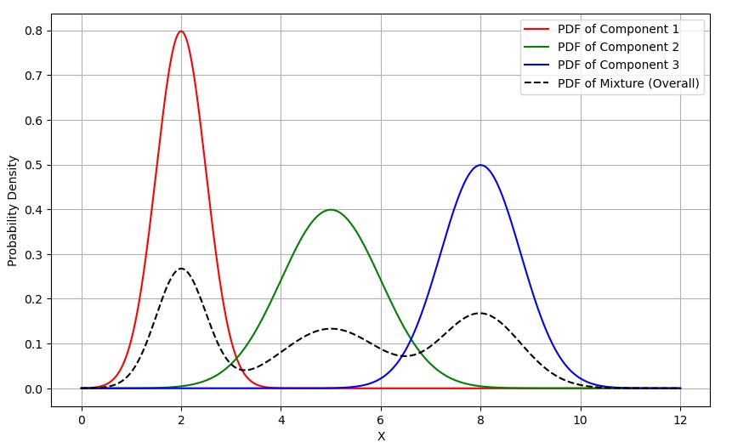
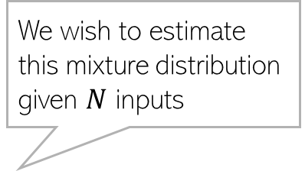
An LVM: Gaussian Mixture Model
Inputs are assumed generated from a mixture of Gaussians. But we don’t know which input was generated by which Gaussian
If we knew which input came from which Gaussian (akin to knowing their true labels), the problem is easy – simply estimate each Gaussian using the inputs that came from that Gaussian (just like generative classification)
We wish to estimate this mixture distribution given $N$ inputs

Slide 9
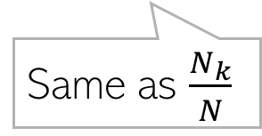

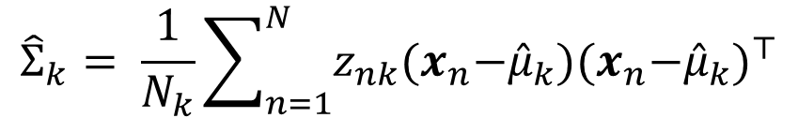
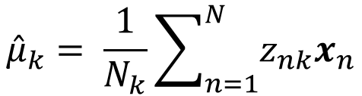
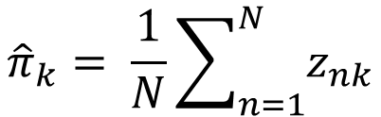
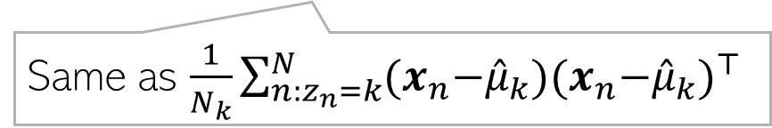
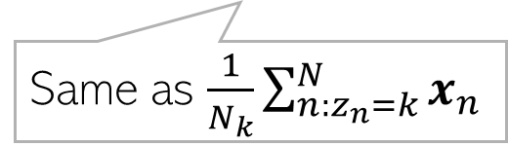
Detour: MLE for Generative Classification
Assume a $K$ class generative classification model with Gaussian class-conditionals
Assume class $k=1,2,…,K$ is modeled by a Gaussian with mean $μ_{k}$ and cov matrix $Σ_{k}$
Can assume label $z_{n}$ to be one-hot and then $z_{nk}=1$if $z_{n}= k$, and $z_{nk}=0$, o/w
Note: For each label, using notation $z_{n}$ instead of $y_{n}$
Assuming class marginal $p$($z_{n}=k)=π_{k}$, the model’s params $Θ={\{π_{k},μ_{k},Σ_{k}\} }_{k=1}^{K}$
The MLE objective $log p\left(X,Z | Θ\right)$is (will provide a note for the proof)
$$Θ_{MLE}= {argmax}_{{\{π_{k},μ_{k},Σ_{k}\} }_{k=1}^{K}} \sum_{n=1}^{N}{\sum_{k=1}^{K}{z_{nk}[log π_{k}+ log 𝒩\left({x_{n}|μ}_{k},Σ_{k}\right)]}}$$
$${\hat{π}}_{k}= \frac{1}{N}\sum_{n=1}^{N}{z_{nk}}$$
$${\hat{μ}}_{k}= \frac{1}{N_{k}}\sum_{n=1}^{N}{z_{nk}x_{n}}$$
$${\hat{Σ}}_{k}= \frac{1}{N_{k}}\sum_{n=1}^{N}{z_{nk}{(x}_{n}−{\hat{μ}}_{k}){{(x}_{n}−{\hat{μ}}_{k})}^{⊤}}$$
Same as $\frac{N_{k}}{N}$
Same as $\frac{1}{N_{k}}\sum_{n:z_{n}=k}^{N}{x_{n}}$
Same as $\frac{1}{N_{k}}\sum_{n:z_{n}=k}^{N}{{(x}_{n}−{\hat{μ}}_{k}){{(x}_{n}−{\hat{μ}}_{k})}^{⊤} }$

Slide 10
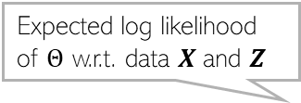
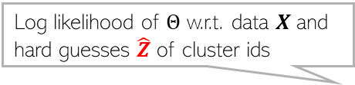




MLE for GMM: Using Guesses of $z_{n}$
Will have the exact same form for the expression of MLE objective as generative classification with Gaussian class-conditionals (except $z_{n}$ is unknown)
Using a hard guess ${\hat{z}}_{n}= {argmax}_{z_{n}} p\left(z_{n} | x_{n},Θ\right)$, the MLE problem for GMM
Using a soft guess $𝔼\left[z_{n}\right]$, the MLE problem for GMM
In both cases, the MLE solution for $Θ={\{π_{k},μ_{k},Σ_{k}\} }_{k=1}^{K}$ will be identical to that of generative classification with Gaussian class cond with $z_{nk}$ replaced by ${\hat{z}}_{nk}$ or $𝔼\left[z_{nk}\right]$
Case 1 solved using ALT-OPT alternating b/w estimating $Θ_{MLE}$ and $\hat{Z}$
Case 2 solved using Expectation Maximization (EM) alternating b/w estimating $Θ_{MLE}$ and $𝔼 [Z]$
Log likelihood of $Θ$ w.r.t. data $X$and hard guesses $\hat{Z}$ of cluster ids
Assuming $x_{n}$ given $z_{n}$ and $Θ$ are i.i.d.
$$Θ_{MLE}= {arg\max_{Θ} log p\left(X,\hat{Z} | Θ\right)= argmax}_{Θ} \sum_{n=1}^{N}{\sum_{k=1}^{K}{{\hat{z}}_{nk}[log π_{k}+ log 𝒩\left({x_{n}|μ}_{k},Σ_{k}\right)]}}$$
$z_{nk}$ appears at only one place in the log likelihood expression so easily replaced by expectation of $z_{nk}$ w.r.t the CP $p\left(z_{n} | x_{n},Θ\right)$
Expected log likelihood of $Θ$ w.r.t. data $X$and $Z$
$$Θ_{MLE}=arg\max_{Θ} 𝔼\left[log p\left(X,Z | Θ\right)\right]={argmax}_{Θ} \sum_{n=1}^{N}{\sum_{k=1}^{K}{𝔼\left[z_{nk}\right][log π_{k}+ log 𝒩\left({x_{n}|μ}_{k},Σ_{k}\right)]}}$$

Slide 11







ALT-OPT for GMM
We will assume we have a “hard” (most probable) guess of $z_{n}$, say ${\hat{z}}_{n}$
ALT-OPT which maximizes $log p\left(X,\hat{Z} | Θ\right)$would look like this
Initialize $Θ= {\{π_{k}, μ_{k}, Σ_{k}\}}_{k=1}^{K}$ as $\hat{Θ}$
Repeat the following until convergence
For each $n$, compute most probable value (our best guess) of $z_{n}$ as
Solve MLE problem for $Θ$using most probable $z_{n}$’s
Proportional to prior prob times likelihood, i.e., $p\left(z_{n}=k | \hat{Θ}\right) p\left(x_{n} | z_{n}=k,\hat{Θ}\right)$ =${\hat{π}}_{k}𝒩\left(x_{n}|{\hat{μ}}_{k},{\hat{Σ}}_{k}\right)$
Posterior probability of point $x_{n}$ belonging to cluster $k$, given current $Θ$
$${\hat{z}}_{n}={argmax}_{k=1,2,…, K} p\left(z_{n}=k | \hat{Θ}, x_{n}\right)$$
$\hat{Θ}= {argmax}_{Θ } \sum_{n=1}^{N}{\sum_{k=1}^{K}{{\hat{z}}_{nk}[log π_{k}+ log𝒩\left({x_{n}|μ}_{k},Σ_{k}\right)]}}$
$N_{k}$ : Effective number of points in cluster k
$${\hat{π}}_{k}= \frac{1}{N}\sum_{n=1}^{N}{{\hat{z}}_{nk}}$$
$${\hat{μ}}_{k}= \frac{1}{N_{k}}\sum_{n=1}^{N}{{\hat{z}}_{nk}x_{n}}$$
$${\hat{Σ}}_{k}= \frac{1}{N_{k}}\sum_{n=1}^{N}{{\hat{z}}_{nk}{(x}_{n}−{\hat{μ}}_{k}){{(x}_{n}−{\hat{μ}}_{k})}^{⊤}}$$

Slide 12










Expectation-Maximization (EM) for GMM
Why w.r.t. this distribution? Will see justification in a bit
EM finds $Θ_{MLE}$ by maximizing $𝔼\left[log p\left(X,Z | Θ\right)\right]$
Note: Expectation will be w.r.t. the CP of $Z$, i.e., $p(Z|X,Θ)$
The EM algorithm for GMM operates as follows
Initialize $Θ= {\{π_{k}, μ_{k}, Σ_{k}\}}_{k=1}^{K}$ as $\hat{Θ}$
Repeat until convergence
Compute CP $p(Z|X,\hat{Θ})$ using current estimate of $Θ$. Since obs are i.i.d, compute for each $n$ (and for $k=1,2,..K$)
Update $Θ$ by maximizing $𝔼\left[log p\left(X,Z | Θ\right)\right]$
Note that EM for GMM also gives a soft clustering $z_{n}=[γ_{n1},γ_{n2},…, γ_{nK}]$ for each input $x_{n}$
Same as $p(z_{nk}=1| x_{n},\hat{Θ}),$just a different notation
$$p\left(z_{n}=k | x_{n},\hat{Θ}\right)∝p\left(z_{n}=k | \hat{Θ}\right) p\left(x_{n} | z_{n}=k,\hat{Θ}\right)\text{ =} {\hat{π}}_{k}𝒩\left(x_{n}|{\hat{μ}}_{k},{\hat{Σ}}_{k}\right)$$
$\frac{{\hat{π}}_{k}𝒩\left(x_{n}|{\hat{μ}}_{k},{\hat{Σ}}_{k}\right)}{\sum_{ℓ=1}^{K}{{\hat{π}}_{ℓ}𝒩\left(x_{n}|{\hat{μ}}_{ℓ},{\hat{Σ}}_{ℓ}\right)}}$
$${\hat{Θ}={argmax}_{Θ} 𝔼}_{p(Z|X,\hat{Θ})}\left[log p\left(X,Z | Θ\right)\right]{=argmax}_{Θ}\sum_{n=1}^{N}{\sum_{k=1}^{K}{𝔼[z_{nk}][log π_{k}+ log 𝒩\left({x_{n}|μ}_{k},Σ_{k}\right)]}}$$
$${\hat{π}}_{k}= \frac{1}{N}\sum_{n=1}^{N}{𝔼[z_{nk}]}$$
$${\hat{μ}}_{k}= \frac{1}{N_{k}}\sum_{n=1}^{N}{𝔼[z_{nk}]x_{n}}$$
$𝔼\left[z_{nk}\right]=γ_{nk}= 0×p(z_{nk}=0|x_{n},$ $\hat{Θ})+1×$ $p(z_{nk}=1|x_{n},$ $\hat{Θ})$
Solution has a similar form as ALT-OPT (or gen. class.), except we now have the expectation of $z_{nk}$being used
$= p(z_{nk}=1|x_{n},$ $\hat{Θ})$
Posterior probability of $x_{n}$ belonging to $k^{th}$ cluster
$${\hat{Σ}}_{k}= \frac{1}{N_{k}}\sum_{n=1}^{N}{𝔼[z_{nk}]{(x}_{n}−{\hat{μ}}_{k}){{(x}_{n}−{\hat{μ}}_{k})}^{⊤}}$$
$∝$ ${\hat{π}}_{k}𝒩\left(x_{n}|{\hat{μ}}_{k},{\hat{Σ}}_{k}\right)$

Slide 13


EM for GMM (Contd)
Accounts for fraction of points in each cluster
Accounts for cluster shapes (since each cluster is a Gaussian
Soft K-means, which are more of a heuristic to get soft-clustering, also gave us probabilities but didn’t account for cluster shapes or fraction of points in each cluster
Effective number of points in the $k^{th}$cluster
M-step:

Slide 14



What is EM Doing?
Assuming $Z$ to be discrete, else replace it by an integral
Maximization of ILL
The MLE problem was $Θ_{MLE}=arg\max_{Θ} log p\left(X | Θ\right)= arg\max_{Θ} log\sum_{z}{p\left(X,Z | Θ\right)}$
What EM (and ALT-OPT) maximized is expected CLL: $Θ_{MLE}=arg\max_{Θ} 𝔼\left[log p\left(X,Z | Θ\right)\right]$
We did not solve the original problem (max of ILL). Is it okay?
Assume $p_{z} = p(Z|X,Θ)$ and $q(Z)$ to be some prob distribution over $Z,$ then
In the above $ℒ\left(q,Θ\right)= \sum_{Z}{q\left(Z\right)log\left\{\frac{p(X,Z|Θ)}{q(Z)}\right\}}$ and $KL(q|\left|p_{z}\right)=−\sum_{Z}{q\left(Z\right)log\left\{\frac{p(Z|X,Θ)}{q(Z)}\right\}}$
Since KL is always non-negative $log p\left(X | Θ\right)≥$ $ℒ\left(q,Θ\right)$, so $ℒ\left(q,Θ\right)$ is a lower-bound on ILL
Thus if we maximize $ℒ\left(q,Θ\right)$, it will also improve $log p\left(X | Θ\right)$
As an approximation
Function of a distribution $q$ and parameter $Θ$
$$log p\left(X | Θ\right)= ℒ\left(q,Θ\right)+KL(q||p_{z})$$
May verify this identity

Slide 15
What is EM Doing?
The posterior distribution of $Z$ given older parameters $Θ^{old}$ (will need this posterior to get the expectation of CLL)
As we saw, $ℒ\left(q,Θ\right)$ depends on $q$ and $Θ$
Let’s maximize $ℒ\left(q,Θ\right)$ w.r.t. $q$ with $Θ$ fixed at $Θ^{old}$
Now let’s maximize $ℒ\left(q,Θ\right)$ w.r.t. $Θ$ with $q$ fixed at $\hat{q}=p_{z}=p(Z|X,Θ^{old})$
Since $log p\left(X | Θ\right)= ℒ\left(q,Θ\right)+KL(q||p_{z})$ is constant when $Θ$ is held fixed at $Θ^{old}$
$$\hat{q}= {argmax}_{q}ℒ\left(q,Θ^{old}\right)= {argmin}_{q}KL(q|\left|p_{z}\right)=p_{z}=p(Z|X,Θ^{old})$$
$$Θ^{new}= {argmax}_{Θ}ℒ\left(\hat{q},Θ\right)= {argmax}_{Θ}\sum_{Z}{p(Z|X,Θ^{old}) log\left\{\frac{p(X,Z|Θ)}{p(Z|X,Θ^{old}) }\right\}}$$
$$= {argmax}_{Θ}\sum_{Z}{p\left(Z | X,Θ^{old}\right) log p(X,Z|Θ)}$$
Maximization of expected CLL w.r.t. the posterior distribution of $Z$ given older parameters $Θ^{old}$
$$= {argmax}_{Θ} 𝔼_{p\left(Z | X,Θ^{old}\right)}[log p(X,Z|Θ)]$$
$$= {argmax}_{Θ} 𝒬(Θ,Θ^{old})$$

Slide 16


Recap: ALT-OPT vs EM
This step could potentially throw away a lot of information about the latent variable $Z$
ALT-OPT can be seen as as approximation of EM – the posterior $p(Z|X,Θ)$ is replaced by a point mass at its mode

Slide 17
EM: An Illustration
Alternating between them until convergence to some local optima
Makes $ℒ\left(q,Θ\right)$ equal to $log p\left(X | Θ\right)$; thus the curves touch at current $Θ$
As we saw, EM maximizes the lower bound $ℒ\left(q,Θ\right)$ in two steps
Step 1 finds the optimal $q$ (call it $\hat{q}$) by setting it the posterior of $Z$ given current $Θ$
Step 2 maximizes $ℒ\left(\hat{q},Θ\right)$ w.r.t. $Θ$which gives a new $Θ$.
Note that $Θ$only changes in Step 2 so the objective $log p\left(X | Θ\right)$
can only change in Step 2
Local optima found for $Θ_{MLE}$
Green curve: $ℒ\left(\hat{q},Θ\right)$ after setting $q$ to $\hat{q}$
$$log p\left(X | Θ\right)$$
Also kind of similar to Newton’s method (and has second order like convergence behavior in some cases)
Good initialization matters; otherwise would converge to a poor local optima
Unlike Newton’s method, we don’t construct and optimize a quadratic approximation, but a lower bound
Even though original MLE problem ${argmax}_{Θ}log p\left(X | Θ\right)$ could be solved using gradient methods, EM often works faster and has cleaner updates
$$Θ^{(0)}$$
$$Θ^{(1)}$$
$$Θ^{(2)}$$
$$Θ^{(3)}$$
$$Θ^{(MLE)}$$

Slide 18


The EM Algorithm in its general form..
Maximization of $ℒ\left(q,Θ\right)$ w.r.t. $q$ and $Θ$ gives the EM algorithm (Dempster, Laird, Rubin, 1977)
Note: If we can take the MAP estimate ${\hat{z}}_{n}$ of $z_{n}$ (not full posterior) in Step 2 and maximize the CLL in Step 3 using that, i.e., do ${argmax}_{Θ}\sum_{n=1}^{N}{\left[log p\left(x_{n}, {{\hat{z}}_{n}}^{(t)} | Θ\right)\right]}$ this will be ALT-OPT

Slide 19


The Expected CLL
Expected CLL in EM is given by (assume observations are i.i.d.)
If $p\left(z_{n} | Θ\right)$ and $p\left(x_{n} | z_{n},Θ\right)$ are exponential family distributions, then $𝒬(Θ,Θ^{old})$ has a very simple form
In resulting expressions, replace terms containing $z_{n}$’s by their respective expectations, e.g.,
$z_{n}$ replaced by $𝔼_{p\left(z_{n} | x_{n},\hat{Θ}\right)}[z_{n}]$
$z_{n}{z_{n}}^{⊤}$ replaced by $𝔼_{p\left(z_{n} | x_{n},\hat{Θ}\right)}[z_{n}{z_{n}}^{⊤}]$
However, in some LVMs, these expectations are intractable to compute and need to be approximated (beyond the score of CS771)
Was indeed the case of GMM: $p\left(z_{n} | Θ\right)$ was multinoulli, $p\left(x_{n} | z_{n},Θ\right)$ was Gaussian

Slide 20
Detour: Exponential Family
Exponential Family is a family of prob. distributions that have the form
Many well-known distribution (Bernoulli, Binomial, multinoulli, Poisson, beta, gamma, Gaussian, etc.) are examples of exponential family distributions
$θ$ is called the natural parameter of the family
$h\left(x\right), T\left(x\right),$ and $A(θ)$ are known functions (specific to the distribution)
$T(x)$ is called the sufficient statistics: estimates of $θ$contain $x$ in form of suff-stats
Every exp. family distribution also has a conjugate distribution (often also in exp. family)
Also, MLE/MAP is usually quite simple since $log p\left(x | θ\right)$ will have a simple expression
Also useful in fully Bayesian inference since they have conjugate priors
$$p\left(x | θ\right)=h\left(x\right)exp[θ^{⊤}T\left(x\right)−A(θ)]$$
Even though their standard form may not look like this, they can be rewritten in this form after some algebra
Natural params are a function of the distribution parameters in the standard form
https://en.wikipedia.org/wiki/Exponential_family

Slide 21


LVM for Semi-supervised Learning
Unlabeled data can help in supervised learning as well
Added some unlabeled inputs (green points)
We don’t know their true labels but can treat the true labels as latent variables and estimate them along with the rest of the parameters of the generative classification model
A generative classifier learned using the labelled examples
Decision boundary (green curve)
A small training set may not be able to help learn the true decision boundary
New (improved)decision boundary

Slide 22



LVM for Semi-supervised Learning (SSL)
Suppose we have $N$ labeled ${\left\{x_{n}, y_{n}\right\}}_{n=1}^{N}$ and $M$ unlabeled examples ${\left\{x_{n}\right\}}_{n=N+1}^{N+M}$
We wish to learn a classifier using both labelled and unlabeled examples
We can treat the labels of ${\left\{x_{n}\right\}}_{n=N+1}^{N+M}$ as latent variables and use ALT-OPT or EM
$z_{n}=y_{n}$ for labeled examples $n=1,2,…, N$
$z_{n}$ estimated (hard/soft guess) for unlabeled examples $n=N+1,…, N+M$
Assuming generative classification with Gaussian class-conditional ($Θ= {\{π_{k}, μ_{k}, Σ_{k}\}}_{k=1}^{K}$ )
This SSL model is a hybrid of supervised generative classification (with Gaussian class-conditionals) and GMM
$$\hat{Θ}{=argmax}_{Θ}\sum_{n=1}^{N}{z_{nk}[log π_{k}+ log 𝒩\left({x_{n}|μ}_{k},Σ_{k}\right)]}$$
Assuming we are using EM (soft guess), otherwise ALT-OPT (hard guess) can be used too, as we did in GMM
$$+\sum_{n=N+1}^{N+M}{\sum_{k=1}^{K}{𝔼[z_{nk}][log π_{k}+ log 𝒩\left({x_{n}|μ}_{k},Σ_{k}\right)]}}$$

Slide 23







Another LVM: Probabilistic PCA (PPCA)
23
Assume $x_{n}∈ℝ^{D}$ as a linear mapping of a latent var $z_{n}∈ℝ^{K}$ + Gaussian noise
Equivalent to saying $p\left(x_{n} | z_{n}, μ, W,σ^{2}\right)= 𝒩\left(x_{n}|μ+Wz_{n},σ^{2}I_{D}\right)$
Assume a zero-mean $K$-dim Gaussian prior on $z_{n}$, so $p\left(z_{n}\right)= 𝒩\left(z_{n}|0, I_{K}\right)$
We would like to do MLE for $Θ=(μ, W, σ^{2})$
ILL for this model $p\left(x_{n} | μ, W,σ^{2}\right)$ is also a Gaussian (thanks to Gaussian properties)
Maximizing ILL w.r.t. $Θ=(μ, W, σ^{2})$ is possible but requires solving eig decomp. problem
We can use ALT-OPT/EM to estimate $Θ=(μ, W, σ^{2})$ more efficiently without eig decomp.
A “reverse” generative way of thinking about PCA (low-dim $z_{n}$ generating high-dim $x_{n}$
$D×1$ offset/bias
$D× K$matrix
Drawn from a zero-mean $D$-dim Gaussian $𝒩\left(0,σ^{2}I_{D}\right)$
This linear mapping can be replaced by more powerful nonlinear mapping of the form $x_{n}=f(z_{n})+ε_{n}$ where $f$ can be modeled using a deep neural net (e.g., models like variational autoencoders)
$$x_{n}=μ+Wz_{n}+ε_{n}$$
$$p\left(x_{n} | μ, W,σ^{2}\right)=\int{p\left(x_{n} | z_{n}, μ, W,σ^{2}\right)p\left(z_{n}\right)dz_{n}= }N\left(x_{n} | μ,WW^{⊤}+σ^{2}I_{D}\right)$$
PRML 12.2.1

Slide 24



Learning PPCA using EM
Instead of maximizing the ILL $p\left(x_{n} | μ, W,σ^{2}\right)=N\left(x_{n} | μ,WW^{⊤}+σ^{2}I_{D}\right)$, let’s use ALT-OPT/EM
EM will instead maximize expected CLL, with CLL (assume $μ=0)$ given by
Using $p\left(x_{n} | z_{n}, W,σ^{2}\right)= 𝒩\left(x_{n}|Wz_{n},σ^{2}I_{D}\right)$ and $p\left(z_{n}\right)= 𝒩\left(z_{n}|0, I_{K}\right)$
Expected CLL will require $𝔼\left[z_{n}\right]$ and $𝔼\left[z_{n}z_{n}^{⊤}\right]$ w.r.t. conditional posterior of $z_{n}$
$$log p\left(X,Z | W,σ^{2}\right)= log \prod_{n=1}^{N}{p(x_{n},z_{n}|W,σ^{2})}=log \prod_{n=1}^{N}{p\left(x_{n} | z_{n},W,σ^{2}\right)}p(z_{n})$$
$$CLL=− \sum_{n=1}^{N}{\left\{\frac{D}{2} log σ^{2}+\frac{1}{2σ^{2}} {\left\|x_{n}\right\|}^{2}−\frac{1}{σ^{2}} z_{n}^{⊤}W^{⊤}x_{n}+\frac{1}{2σ^{2}} trace(z_{n}z_{n}^{⊤}W^{⊤}W)+\frac{1}{2} trace(z_{n}z_{n}^{⊤})\right\}}$$
Using the fact that $p(x_{n}|z_{n})$ and $p(z_{n})$ are Gaussians and the CP is just the reverse conditional $p(z_{n}|x_{n})$ and must also be Gaussian

Slide 25






Learning PPCA using EM
The EM algo for PPCA alternates between two steps
Compute CP of $z_{n}$given parameters $Θ = (W,σ^{2})$ and required expectatuions
Maximize the expected CLL $𝔼\left[log p(X,Z|W,σ^{2})\right]$ w.r.t. $W$ and $σ^{2}$
Will get ALT-OPT if we use mode of the CP as ${\hat{z}}_{n}$ in the CLL
Note: This approach does not assume/ensure that $W$ is orthonormal
$$𝔼[CLL]=− \sum_{n=1}^{N}{\left\{\frac{D}{2} log σ^{2}+\frac{1}{2σ^{2}} {\left\|x_{n}\right\|}^{2}−\frac{1}{σ^{2}} {𝔼[z}_{n}^{⊤}]W^{⊤}x_{n}+\frac{1}{2σ^{2}} trace({𝔼[z}_{n}z_{n}^{⊤}]W^{⊤}W)+\frac{1}{2} trace({𝔼[z}_{n}z_{n}^{⊤}])\right\}}$$
Unlike standard PCA (non-probabilistic), no eigendecomposition needed to estimate $W$
Note: setting $σ^{2}=0$ makes it equivalent to standard PCA without orthonormality constraint, but EM is more efficient since no eigendecomposition is needed

Slide 26


Generative Models can generate synthetic data!
Once parameters $Θ=(μ, W, σ^{2})$ are learned, we can even generate new data, e.g.,
Generate a random $z_{n}$ from $𝒩\left(0, I_{K}\right)$
Generate $x_{n}$ condition on $z_{n}$ from $𝒩\left(μ+Wz_{n},σ^{2}I_{D}\right)$
In addition to, of course, reducing the data dimensionality
Generated using a more sophisticated generative model, not PPCA (but similar in formulation)
Methods such as variational autoencoders, GAN, diffusion models, etc are based on similar ideas

Slide 27


EM: Some Comments
Good initialization is important
The E and M steps may not always be possible to perform exactly. Some reasons
CP of latent variables $p(Z|X,Θ)$ may not be easy to find and may require approx.
Even if $p(Z|X,Θ)$ is easy, expected CLL, i.e., $𝔼\left[log p\left(X,Z | Θ\right)\right]$may still not be tractable
..and may need to be approximated, e.g., using Monte-Carlo expectation
Maximization of the expected CLL may not be possible in closed form
EM works even if the M step is only solved approximately (Generalized EM)
Other advanced probabilistic inference algorithms are based on ideas similar to EM
E.g., Variational Bayesian inference a.k.a. Variational Inference (VI)
EM is also related to non-convex optimization algorithms Majorization-Maximization (MM)
MM maximizes a difficult-to-optimize objective function by iteratively constructing surrogate functions that are easier to maximize (in EM, the surrogate function was the CLL)
Monte-Carlo EM
Gradient methods may still be needed for this step

